Slide 1
Shell Programs

Slide 2
Viewing running processes in Linux
The ps command used to list the currently running processes and their PIDs in Linux and Unix-like systems
short for process status

Slide 3

Ps command
Used without any options,
the ps command displays only processes that are started from the current shell:

Slide 4
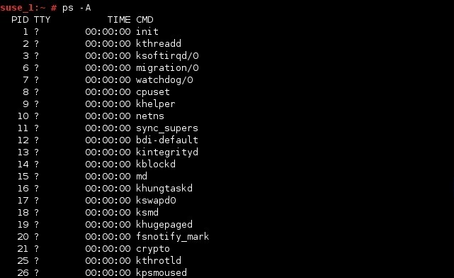
Ps command
To get information about all processes running on the system, use ps -A:

Slide 5
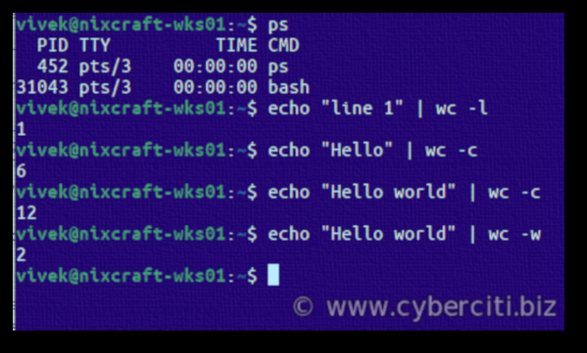
Counts for each file in Linux
The wc is an acronym for word count.
By default, wc command counts the number of lines, words, and characters in the text.
To show the newline counts echo "line 1" | wc -l
To print the byte counts echo "Hello" | wc -c
One can print the word counts as follows: echo "Hello world" | wc -w

Slide 6
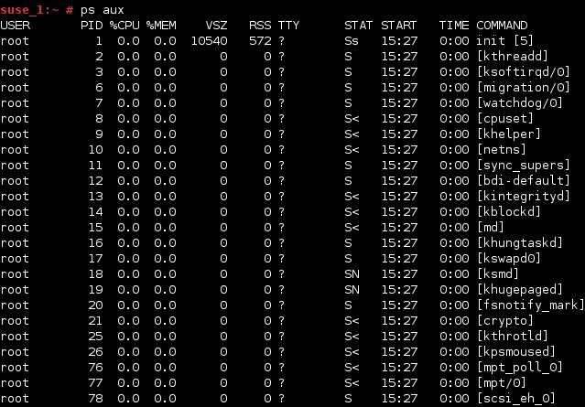
Ps command
The most used options with ps are a, u and x.
This displays all processes running for all users on your system, along with useful information such as the
username of the process′ owner,
CPU loads,
the starting time of the process,
the command that initiated the process, etc.

Slide 7
Ps command
You can just use the ps command piped to the wc command.
This command will count the number of processes running on your system by any user. ps aux | wc -l
To see only processes by a certain user with a username user1, you can use the following command: ps -U user1 | wc -l

Slide 8
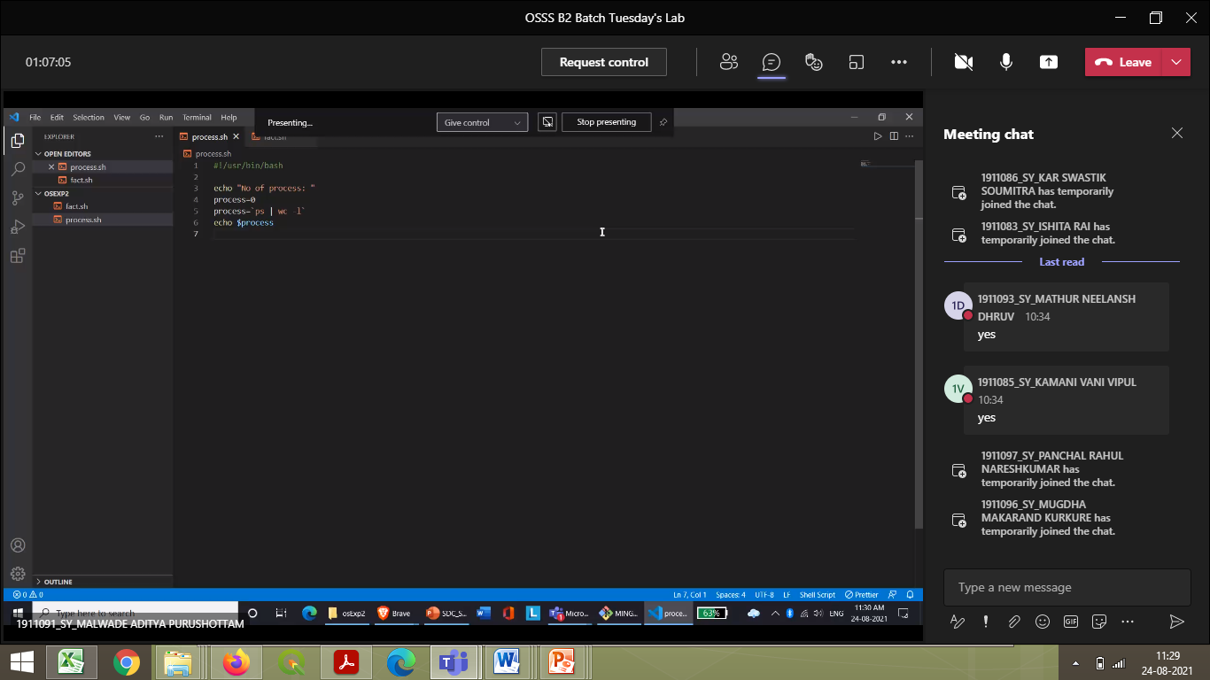
Remove spaces before and after |

Slide 9
Factorial of a number using while loop - Shell Script
#shell script for factorial of a number
#factorial using while loop
echo "Enter a number"
read num
fact=1
while [ $num -gt 1 ]
do
fact=$((fact * num)) #fact = fact * num
num=$((num - 1)) #num = num - 1
done
echo $fact

Slide 10
Factorial of a number using while loop - Shell Script
#shell script for factorial of a number
#factorial using for loop
echo "Enter a number"
read num
fact=1
for((i=2;i<=num;i++))
{
fact=$((fact * i)) #fact = fact * i
}
echo $fact

Slide 11
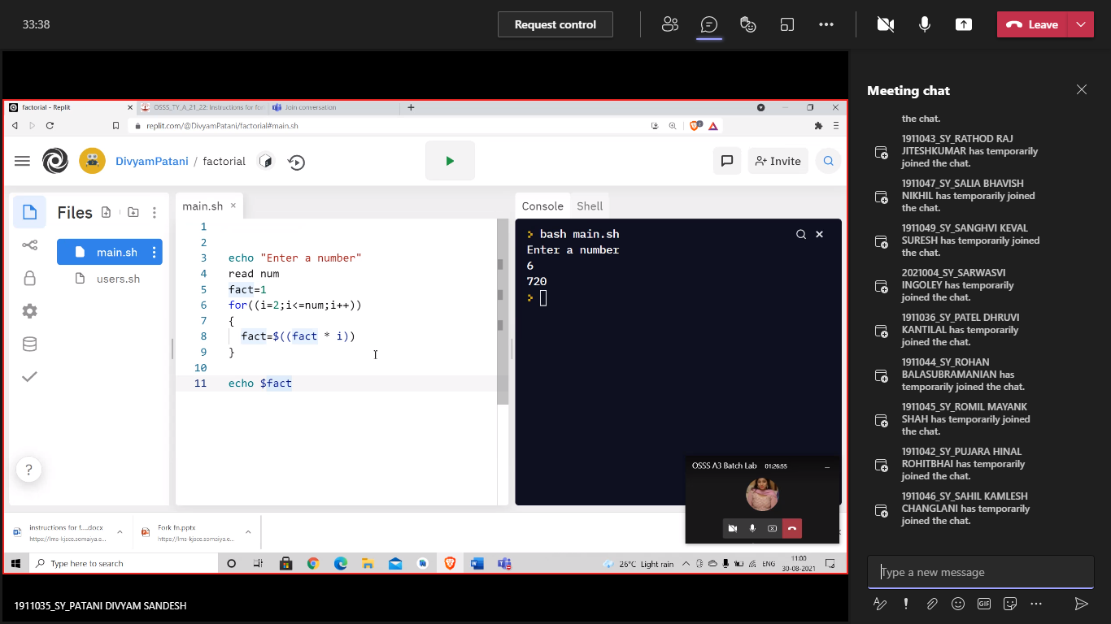

Slide 12
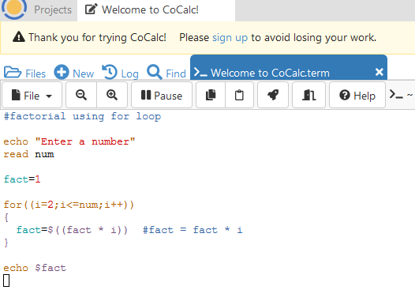
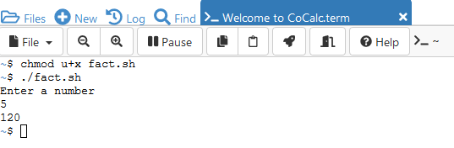
Execution of factorial pgm

Slide 13
useradd command
In Linux, a ‘useradd‘ command is a low-level utility that is used for adding/creating user accounts in Linux and other Unix-like operating systems.
When we run ‘useradd‘ command in Linux terminal, it performs following major things:
It edits /etc/passwd, /etc/shadow, /etc/group and /etc/gshadow files for the newly created User account.
Creates and populate a home directory for the new user.
Sets permissions and ownerships to home directory.
Basic syntax of command is:
useradd [options] username

Slide 14
Useradd
useradd [options] name_of_the_user
To add a simple user
sudo useradd test_user

Slide 15
v
Basic syntax of command is:
useradd [options] username

Slide 16
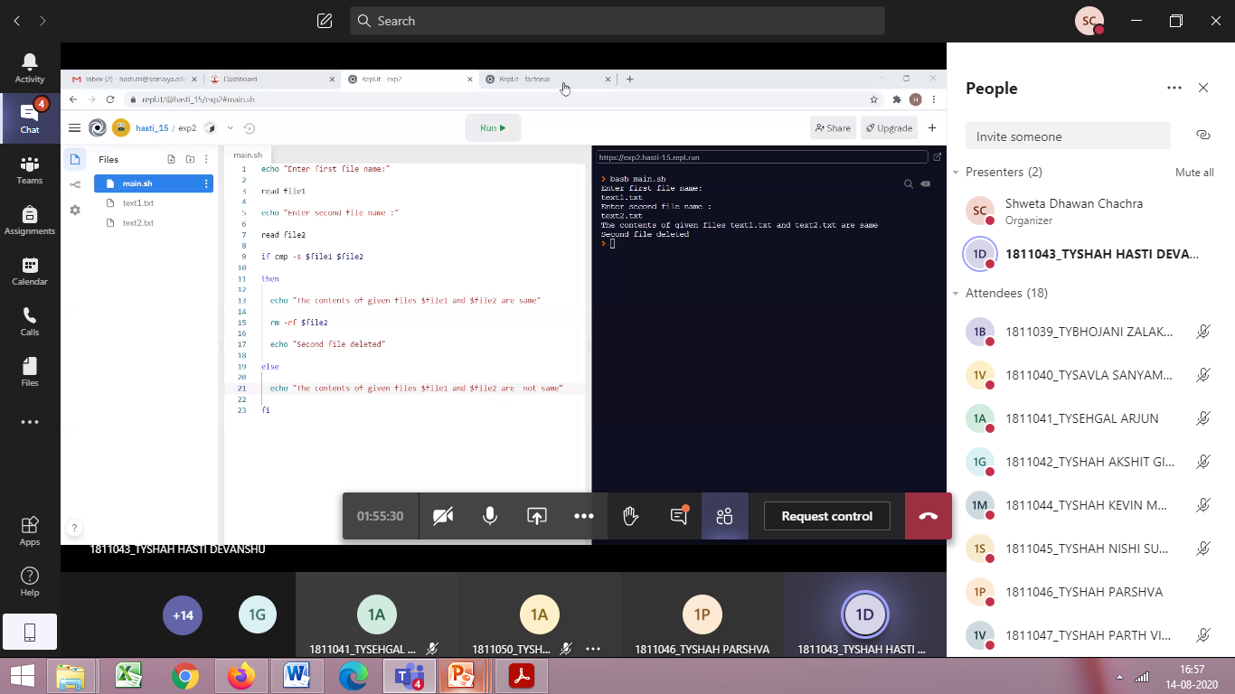
Friday batch

Slide 17
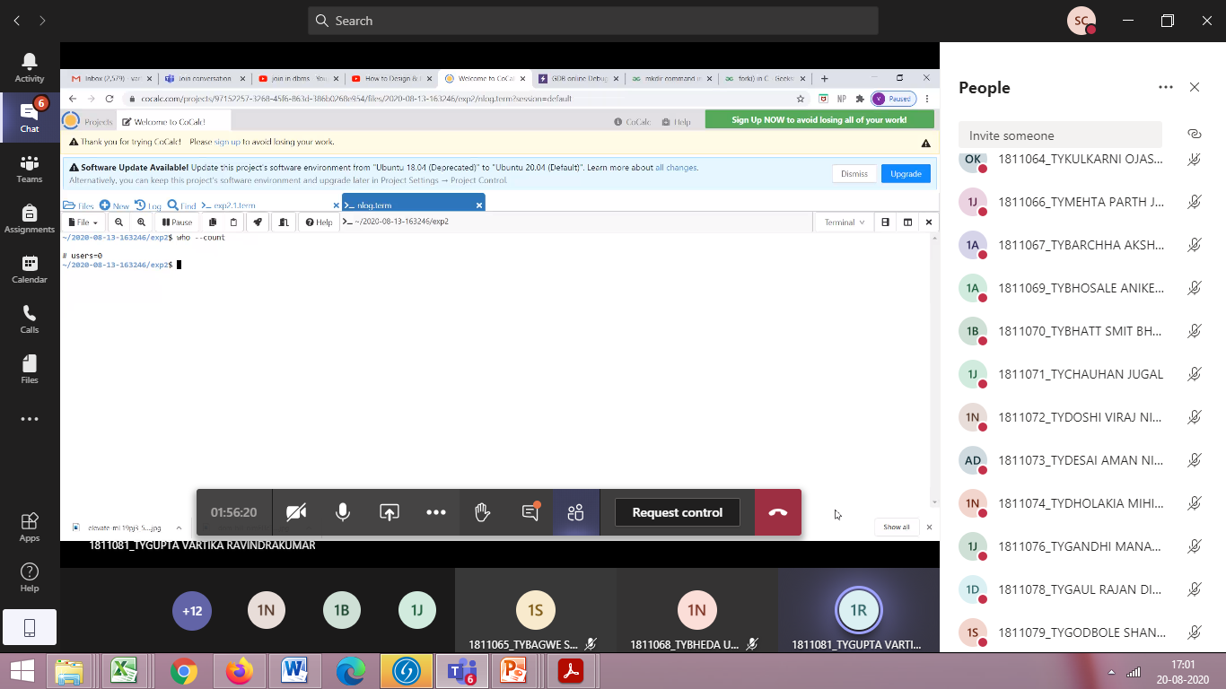
Count no of users $ who --count

Slide 18
